Slide 1
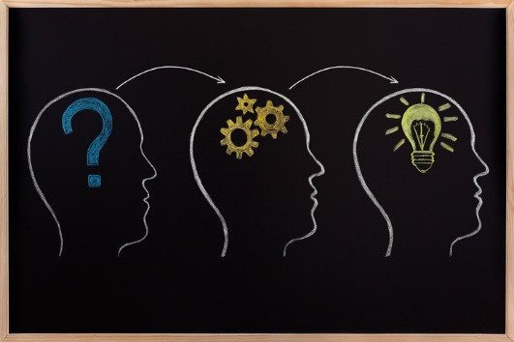
LEARNING STYLES AND MEMORY SKILLS

Slide 2
Learning Styles
Learning styles are different ways of taking in and understanding information.
It refers to a student's consistent way of responding to and using stimuli in the context of learning.
These ways are affected by age, experience, physiology, culture, and many other factors

Slide 3
Learning Styles
Learning styles can change over time and can be modified purposely.
People also switch learning styles depending on what they are studying, as we are all capable of learning under almost any style, no matter what our preference is.

Slide 4
How to discover your learning styles
Each student learns differently.
Learning style is about your preferred way of absorbing, processing, comprehending and retaining information.
To discover your learning style is part of your self discovery.

Slide 5
Types of Learning Styles
There are three major types of learning styles. They are:
Visual
Auditory
Kinaesthetic

Slide 6
Exercise
Look at the following questions and write down your answers.
Just write the first answer that comes to your mind. A, B or C.
It is a personal assessment. So do it yourself

Slide 7
Questions
1. What distracts you most during lectures?
A – Visual items
B – Noise
C – personal worries, hunger, your tight clothe, your tight shoes, etc.

Slide 8
Questions
2. Which class would you rather attend?
A – An art class
B – A music class
C – An exercise or Gym class.
3. What do you still remember vividly from your first party in PAU?
A – Faces of the people there
B – Their names but not faces
C – What you did and said while at the party

Slide 9
Questions
4. How would you express your joy?
A- Grin
B –Shout for joy!
C – Jump for joy
5. What is your reaction to this word now – “i-c-e C-r-e-a-m”
A – to think about ice cream
B – say the word ice cream
C – Sense the feeling of having it

Slide 10
Questions
6. When you share a story, would you rather
A – write it
B- tell it out loud
C – act it out
7. What is your likely expression of anger
A – scowl
B – shout at someone
C –slam the door or bang the table

Slide 11
Where do you belong?
Those that scored more As in the exercise may have aptitude for visual learning.
Those that scored more Bs may have auditory learning ability.
Those with more Cs may have kinaesthetic learning styles.

Slide 12
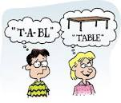
Visual Learners

Slide 13
Visual Learners
Easily close their eyes to envision where they left something.
Call up mental images when studying.
Have a photographic or near photographic memory.

Slide 14
Strengths of Visual Learners
Instinctively follows directions.
Easily visualizes objects.
Have a great sense of balance and alignment and is an excellent organizer.
Have a strong sense of color, and is very color-oriented.

Slide 15
Visual learners
Can see the passage from a page in a book in his or her mind.
Notices minute similarities and differences between objects and people easily.
Can envision imagery easily.

Slide 16
What Visual learners should do
Read the diagrams, maps, and other visuals items in your text.
Make to-do lists in an agenda
Study more in library because you need to see things to remember them, and often, noise will distract you.
Sit near the front so you're better able to see everything.
Use outlines and concept maps to organize your notes.

Slide 17


Slide 18
Strengths of Auditory Learners
Understanding subtle changes in tone in a person's voice.
Writing responses to lectures.
Do well in Oral exams.
Story-telling.
Solving difficult problems.
Working in groups.

Slide 19
What Auditory Learners should do
Participate vocally in class.
Making records of your class notes and listen to them.
Read assignments out loud.
Studying with a partner or group.

Slide 20
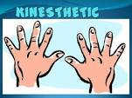

Slide 21
Kinaesthetic Learners
Are movers and shakers of the class.
Prefer to learn by touching and feeling things.
Understand better when gestures are used to explain things.
Are bored in class where they lack opportunity to engage their body in learning.

Slide 22
Strengths of kinaesthetic learners
Great hand-eye coordination.
Quick reception.
Excellent experimenters.
Good at sports, art and drama.
High levels of energy.

Slide 23
What Kinaesthetic learners should do
Conducting experiments.
Acting out a play.
Studying while standing or moving.
Doodling during lectures.
Studying while performing an athletic activity like bouncing a ball or shooting hoops.

Slide 24
Learning styles
Visual, Auditory, Kinesthetic.
Introversion/Extraversion.
Introvert- no impression without reflection. Extrovert -no impression without expression.
Sensing versus Intuition(the ability to understand something instinctively, without the need for conscious reasoning); Thinking versus Feeling; Judging versus Perceptive
Metalearning: to select the best style or modality for the task on hand.

Slide 25
Memory Skills.
Attention: to receive information
Rehearsal: to move to short-term memory
Encoding: to move to long-term memory. i.e., convert the information to your level of understanding and retention. Organize it, make it meaningful, create pictures, use association, etc.
Rehearsal: to remain decodable

Slide 26
Memory skills
To retain piece of information during lecture:
Read topics before class to reduce the amount of new information; ask questions as soon as you miss information; take notes in coded form; review notes as soon as possible.
We tend to remember things…
• Studied first (primacy effect).
• Studied last (recency effect).
• Studied more actively (depth processing)

Slide 27
MEMORY SKILLS
ELABORATION: Connect your new idea to prior ideas. Put in something of yours.
MNEMONICS: Use acronyms, rhyme. E.g. MR. NIGER D, 30 days hath September…..
REFLECTION: Review your classes so that the ideas will stick better.
CALIBRATION: Get feedback that fortify your knowledge. Take quiz from friends.
RETRIEVAL: Bring back from memory using flash cards.
Notes:
References
http://testprep.about.com/od/tipsfortesting/a/Different_Learning_Styles.htm. Retrieved 30/11/2016
http://education.seattlepi.com/advantages-disadvantages-different-learning-styles-3581.html. Retrieved 30/11/2016

Slide 28
Memory skills.
Utilize depth processing as you study.
• Relate new info to your own experience.
• Fit new info into old info.
• Visualize what you are studying.
• Summarize key points.
• Turn key points into mnemonics.

Slide 29
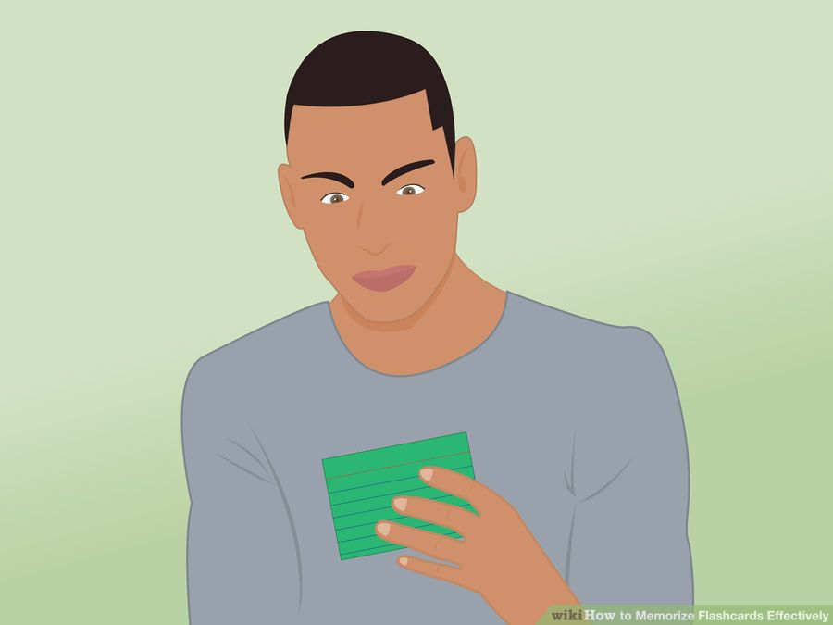
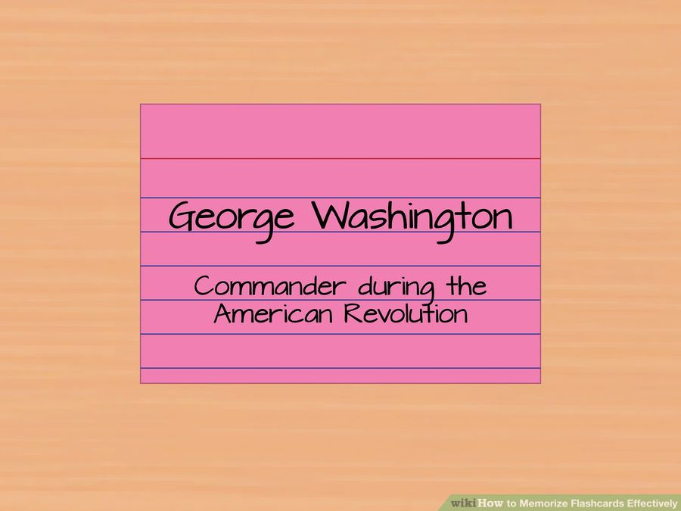
Flash cards

